Slide 1
LSoft Product Roadmap
Which software tool(s) do you need for your IT infrastructure?
Instructions: Click your way through this questionnaire. Find out which product you need and which license type.
Start Quiz

Slide 2
What do you need in your org?
Data Security (Erase)
Data Redundancy (Backup)
Data Recovery (Find)
Disk tools with all of the above

Slide 3
Data Security – What features do you need?
Select most correct option:
Single-pass data wipe & sanitation
PDF Certificates of Erasure & XML Reports
Automated end-to-end workflow for large volumes
Complete, ready-to-go, workstation

Slide 4
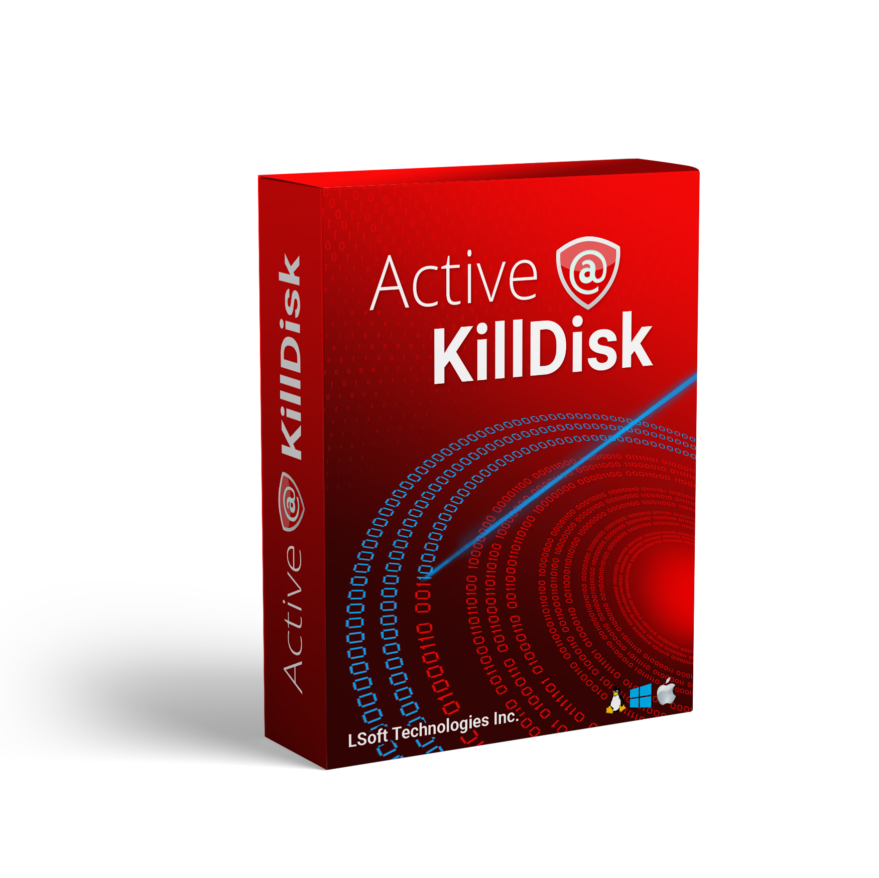
Your product: KillDisk Product line
Find my licensing option:
Ultimate
Includes Linux-based installer & BootDisk
Erase any type of machine (Win/Mac/Linux, 32 or 64-bit), boot from any type of BootDisk (Win/Linux/console)
Pro Suite
32-bit system support (through console BootDisk)
SSD ‘ATA Secure Erase’ support
Pro
Reports & Certificates of erasure
24 international disk sanitation standards supported, including US DoD 5220.22-M & NIST 800-88
Drive health examinations and monitoring
Scripting and automation features for drive sanitation
Freeware
Full single-pass overwrite for drives & partitions
Boot disk creator to use tool with any type of machine
Wipe slack space on drives to prevent file recovery

Slide 5
Data Security – What’s your use case?
Select most correct option:
Occasional computer/drive needs erase from time to time
I erase multiple systems/drives daily
I have a lot of hardware to erase daily
I need something I can plug in and make drive erasure problems go away

Slide 6
Data Security – What does drive erase look like to you?
Select most correct option:
I boot computers & laptops from a USB and erase computers (perhaps automated) without hard drive removal
I boot networked machines in my organization through PXE and erase them remotely without moving much around
I work with a mix of loose drives, laptops and old servers that have data drives and need erasing before reuse/resell
I have piles of loose drives that need sanitation for reuse/resell with more coming next week

Slide 7
Data Security – Hardware or Software?
Select most correct option:
I have my own hardware
Give me something that works without needing to spend time learning an IT instruction manual

Slide 8
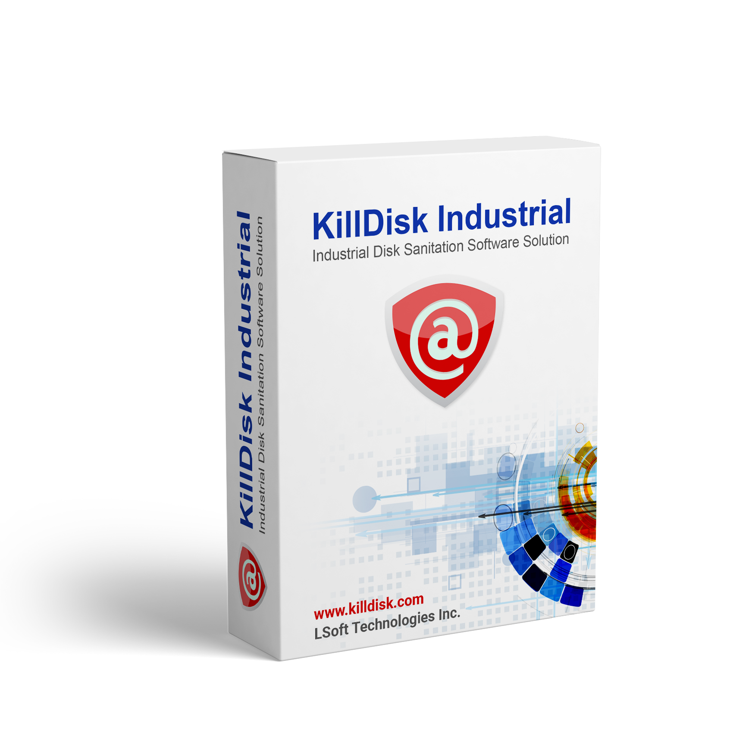

Your Product: KillDisk Industrial Software
Full drive erasure capabilities
Easily customized and automated drive sanitation workflow
Advanced reporting and hardware tracking features
Fully automated end-to-end disk erasure workflow
Support 10 - 100’s of disks concurrently

Slide 9
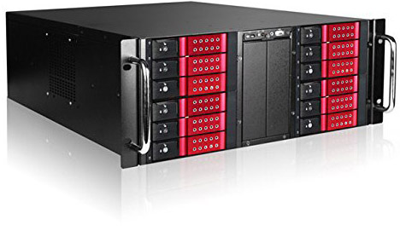
Your product: KillDisk Industrial System
Fully configured, standalone drive-erase workstation
Powered by full-featured KillDisk Industrial Software
Drive cloning features
Supports 10-25 bays, depending on configuration
I need more bays
I need less bays

Slide 10
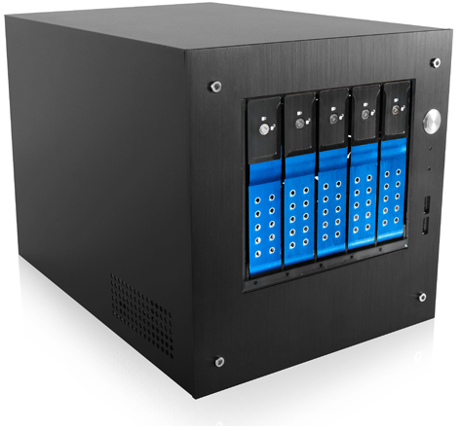
Your product: KillDisk Desktop
Fully configured, standalone drive-erase workstation for office use
Powered by full-featured KillDisk Industrial Software
Drive cloning features
Supports 5-15 bays, depending on configuration

Slide 11
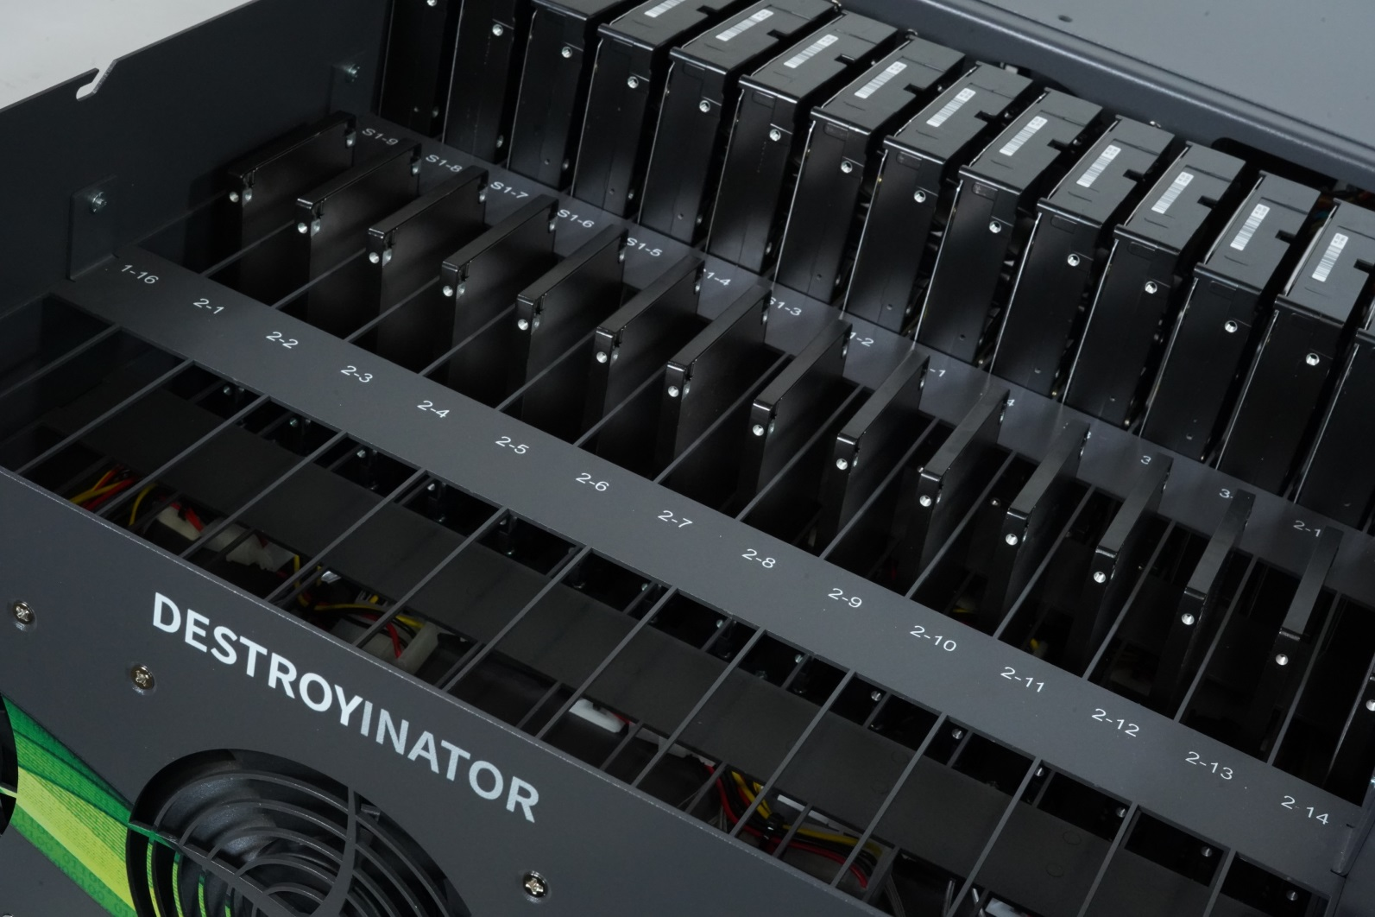
Your product: 45Drives’ Destroynator
Fully configured, standalone drive-erase workstation
Powered by full-featured KillDisk Industrial Software
Supports 30-70 bays, depending on configuration
Custom configurations, rack-mountable
Powerful drive clone features

Slide 12
Backup – Hardware or Software?
Select most correct option:
I have my own hardware, not looking for more
Give me something that works out of the box to clone anything I plug into it

Slide 13
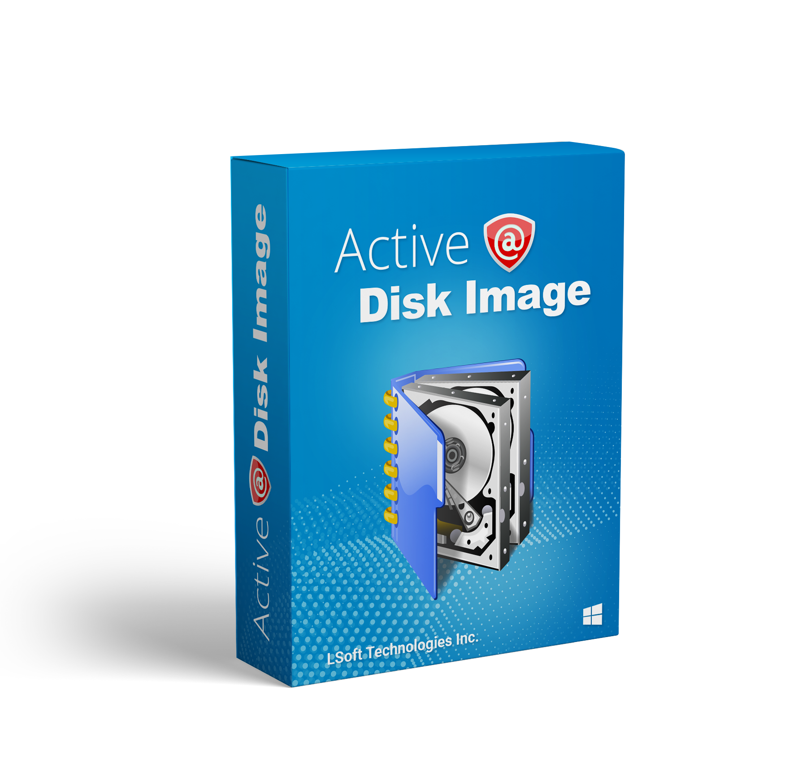
Your product: Active@ Disk Image
Find my licensing option:
Fully configured, standalone drive-erase workstation
Powered by full-featured KillDisk Industrial Software
Supports 30-70 bays, depending on configuration
Custom configurations, rack-mountable
Powerful drive clone features

Slide 14
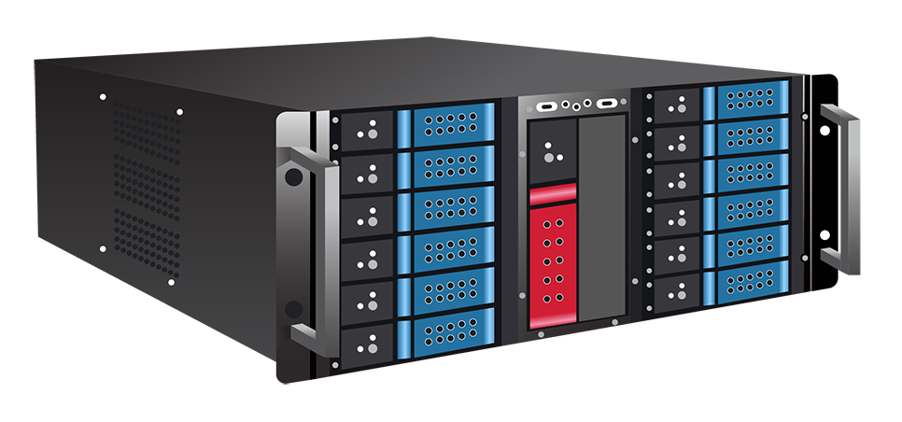
Your product: Disk Clone Industrial
Fully configured, standalone drive-cloning workstation
Powered by full-featured Active@ Disk Image Software
Supports 5-25 bays, depending on configuration
Custom configurations, rack-mountable
Powerful drive clone features

Slide 15
Data Recovery – What are you recovering?
Select most correct option:
I need to recover files
I need to recover entire drives or partitions
I want to recover both, anything and everything that’s possible to recover
I’m not sure if what I have is recoverable

Slide 16
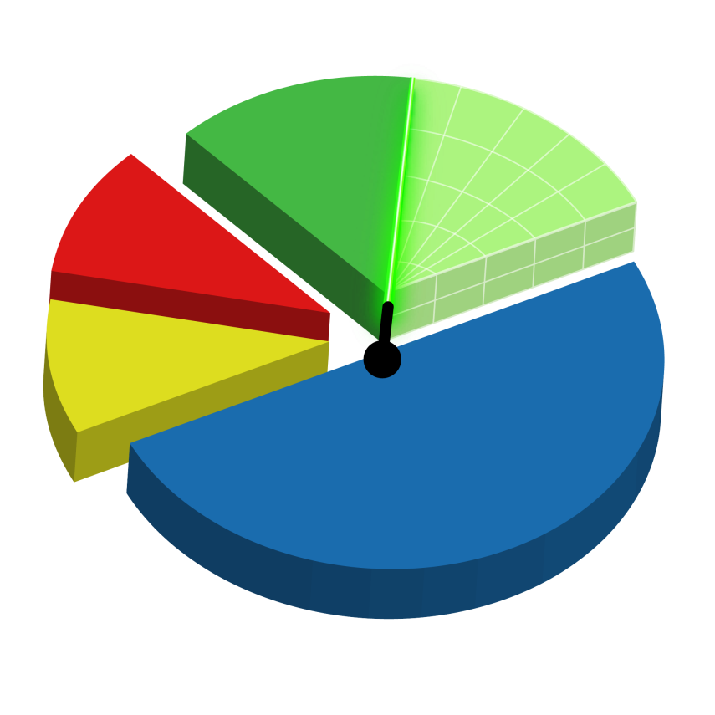
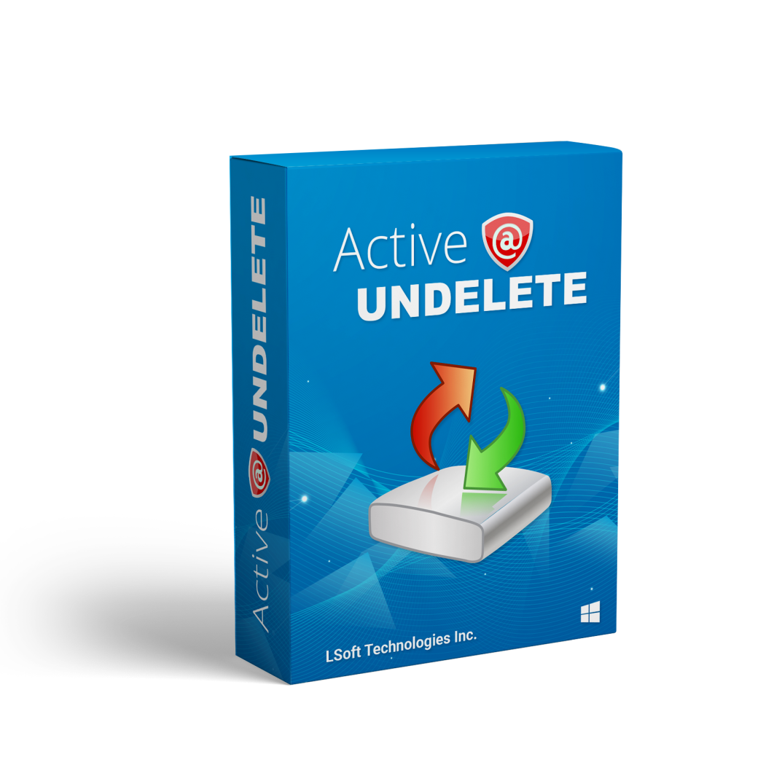
Your product:
Active@ File Recovery / Undelete
Find my licensing option:
File recovery is available in the Standard versions of both Active@ File Recovery & Active@ Undelete

Slide 17
Your product:
Active@ Partition Recovery /
Undelete
Find my licensing option:
Partition recovery is available in Active@ Partition Recovery & the Professional edition of Active@ Undelete

Slide 18
Your product:
Active@ Partition Recovery Ultimate /
Undelete
Find my licensing option:
Active@ Partition Recovery Ultimate includes Active @ File Recovery to recover both
Active@ Undelete Professional supports file & partition recovery, with advanced features like RAID reconstruction and Linux Live USB’s in the Ultimate edition

Slide 19
Your product:
Active@ File Recovery / Undelete
Freeware
Find my licensing option:
Try our File Recovery Freeware software to run scans on your drives and see what files turn up

Slide 20
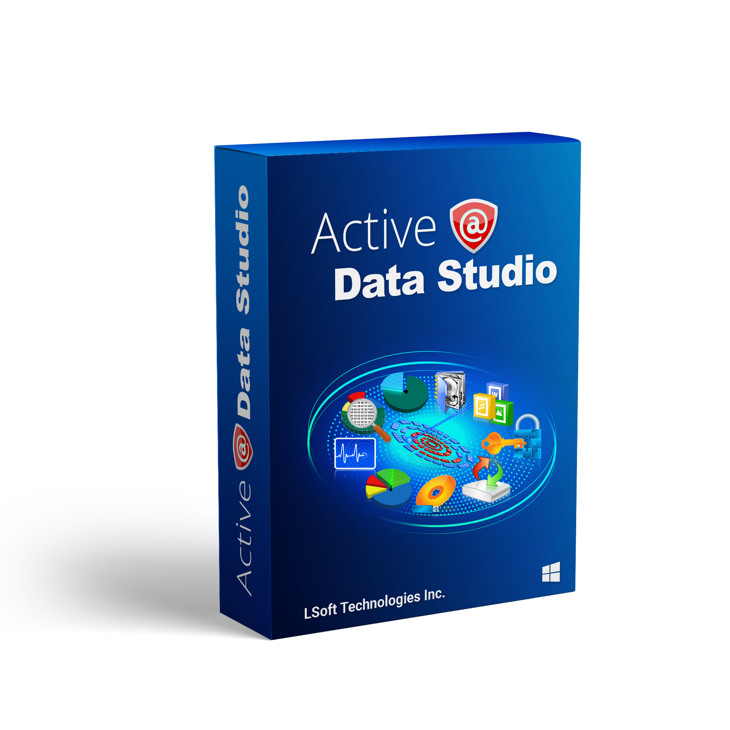
Your product:
Active@ Data Studio
Find my licensing option:
Complete suite of LSoft data utility products
Includes
  Active@ KillDisk
  Active@ File Recovery & Partition Recovery
  Active@ Undelete
  Active@ Password Changer
  Disk utility tools such as: Disk Monitor, Disk Editor, Partition Manager and more…

Slide 21
Licensing options – What license works for me?
Select most correct option:
I’m a nerd or hobbyist using this software on my home computers
I’m buying a license for my IT department
I need my entire company able to maintain their computers with this software, office-wide
My company needs unlimited use of this software, globally

Slide 22
Your License: Personal
Personal | Corporate | Site | Enterprise
a home-use license Support & Updates: $10/year | Licensed to an organization Can be transferred within the org Concurrent software instances and parallel drives erased are limited to Corporate license quantity Support & Updates: $10/year | Unlimited use license Limited to 1 company address, one geographical location Support & Updates: $399/year | Unlimited use license Unlimited global use under your company Support & Updates: $799/year
Software Licensing & Support/Updates Policy:
All new software purchases are covered by 1 year of free software support and updates. Additional support is optional, can be resumed anytime at nominal fee listed. License is perpetual. After support has expired, you may use the last version of the software you left off on as prior. For software support, only the latest version receives active support.

Slide 23
Your License: Corporate
Personal | Corporate | Site | Enterprise
a home-use license Support & Updates: $10/year | Licensed to an organization Can be transferred within the org Concurrent software instances and parallel drives erased are limited to Corporate license quantity Support & Updates: $10/year | Unlimited use license Limited to 1 company address, one geographical location Support & Updates: $399/year | Unlimited use license Unlimited global use under your company Support & Updates: $799/year
Software Licensing & Support/Updates Policy:
All new software purchases are covered by 1 year of free software support and updates. Additional support is optional, can be resumed anytime at nominal fee listed. License is perpetual. After support has expired, you may use the last version of the software you left off on as prior. For software support, only the latest version receives active support.

Slide 24
Your License: Site
Personal | Corporate | Site | Enterprise
a home-use license Support & Updates: $10/year | Licensed to an organization Can be transferred within the org Concurrent software instances and parallel drives erased are limited to Corporate license quantity Support & Updates: $10/year | Unlimited use license Limited to 1 company address, one geographical location Support & Updates: $399/year | Unlimited use license Unlimited global use under your company Support & Updates: $799/year
Software Licensing & Support/Updates Policy:
All new software purchases are covered by 1 year of free software support and updates. Additional support is optional, can be resumed anytime at nominal fee listed. License is perpetual. After support has expired, you may use the last version of the software you left off on as prior. For software support, only the latest version receives active support.

Slide 25
Your License: Enterprise
Personal | Corporate | Site | Enterprise
a home-use license Support & Updates: $10/year | Licensed to an organization Can be transferred within the org Concurrent software instances and parallel drives erased are limited to Corporate license quantity Support & Updates: $10/year | Unlimited use license Limited to 1 company address, one geographical location Support & Updates: $399/year | Unlimited use license Unlimited global use under your company Support & Updates: $799/year
Software Licensing & Support/Updates Policy:
All new software purchases are covered by 1 year of free software support and updates. Additional support is optional, can be resumed anytime at nominal fee listed. License is perpetual. After support has expired, you may use the last version of the software you left off on as prior. For software support, only the latest version receives active support.

